Slide 1
Why Biology?
https://www.youtube.com/watch?v=7L7x0BAqWis
Introduction to Biology

Slide 2
LIF 101 Topic (1)
Laws of inheritance
27 December 2022
Trait
Learning goal:
How traits are transmitted (passed on) from parents to progeny?
Notes:
In genetics, the terms trait and character are used to describe the qualities of the organisms. In an organism, a mixture of two traits occurs, which can be hereditary or determined by external variables. The blue eye colour, for example, is a trait, but the eye colour of the organism is a character.

Slide 3
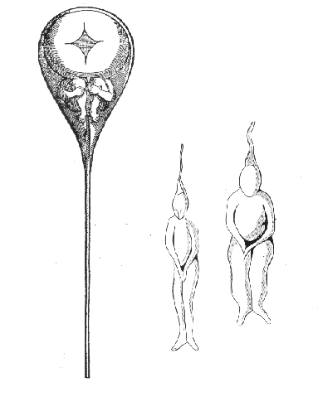
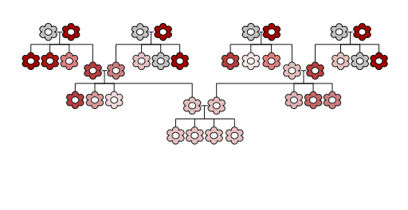
A short Background: Ideas about heredity/inheritance
Blending inheritance
19th Century
Preformation
N. Hartsoecker in 1695

Slide 4
First scientific theory explaining heredity – Mendel’s laws
Principles
Notes:
Heredity: the passing on of physical or mental characteristics genetically from one generation to another
Genetics: The study of genes and heredity. Heredity is the passing of genetic information and traits (such as eye color and an increased chance of getting a certain disease) from parents to offspring.

Slide 5
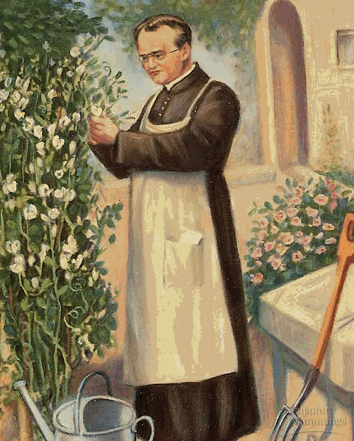
Gregor Johann Mendel (1822 – 1884)
Priest in Augustinian Monastery in Brno, Czechoslovakia
His work with peas laid the foundation for genetics
He cross pollinated the pea plants by brushing pollen from the stamens of one plant to the pistil of another.
Notes:
Mendel was a University educated priest He studied math and science. He returned to the monastery and taught high school. He took care of the monastery’s garden. He was curious why some plants were like their parents & others were not.

Slide 6
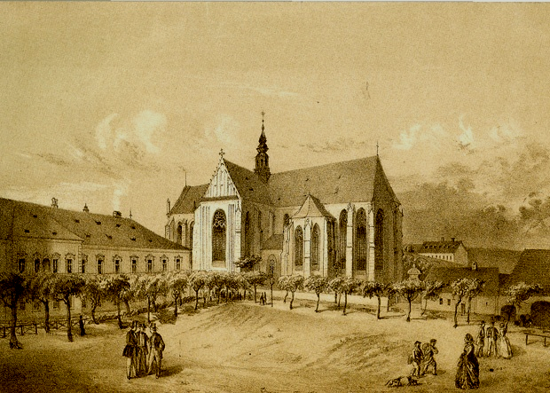
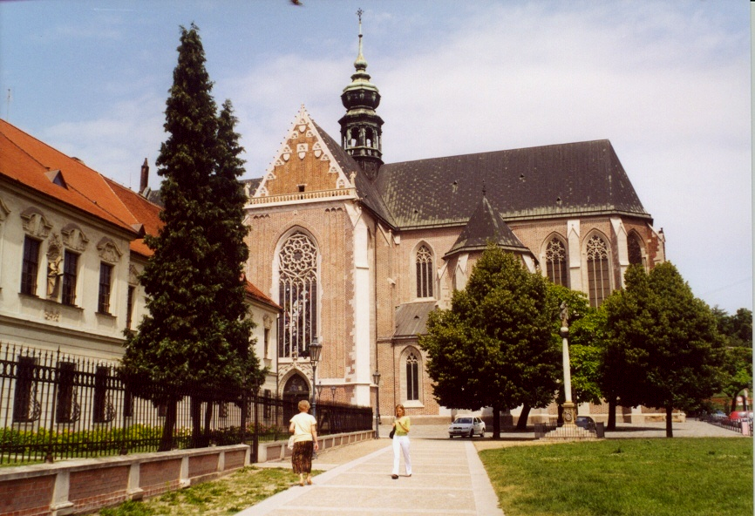
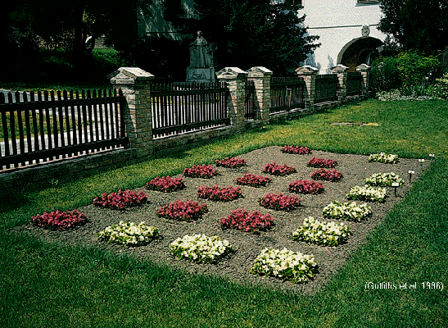
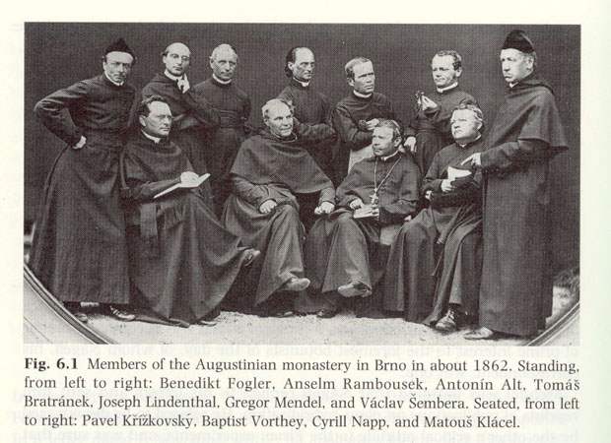
The Augustinian Abbey of St Thomas, Brno
In the early 1800s
About Mendel

Slide 7
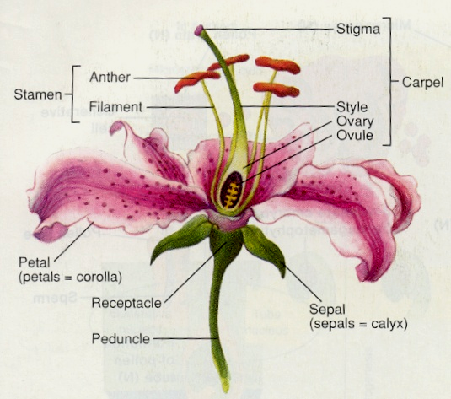
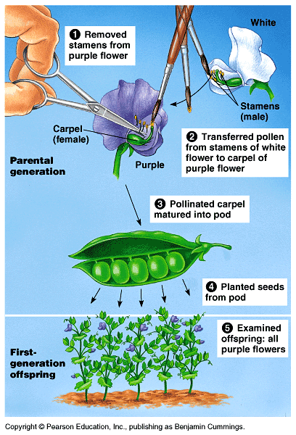
Mendel’s experiment
Flower:
Plant organ for sexual reproduction, that produces gametes (sex cells) and are necessary for fertilization to occur
Note that there are specialized organs for reproduction

Slide 8
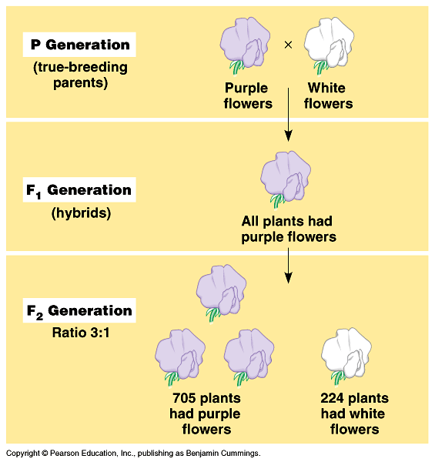
Mendel’s work represent one of the earliest example of experimental biology
What is true breeding?
Does this mean blending of inheritance?
Step 1 :
Carry out an experiment
&
examine the results
Does this refute/discard blending of inheritance?
What are P, F1 and F2

Slide 9
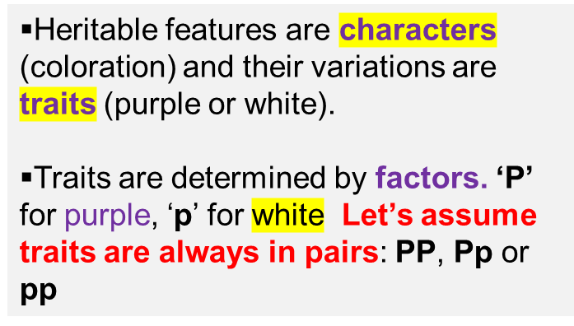
Step 2 : Make assumptions based on the observations
Pp
When two factors are present in the same individual one is seen physically – this is thus dominant (purple) while the other one (white) is recessive
Characteristics “seen” in an individual constitutes its phenotype (appearance). Characteristic “present” in an individual constitutes its genotype.
pp
Note the terminologies introduced : character, trait, factors, dominant, recessive, phenotype, genotype.
Can you define these terms now?
Let’s now see if these assumptions help explain the results
Notes:
F1= First filial, F2 = second filial
Filial: 1. In genetics, the first generation that results from the crossing of two parental lines, as the filial generation.

Slide 10
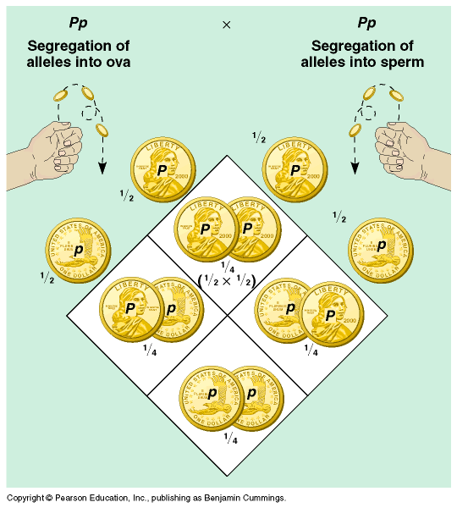
Step 3: Explain the results based on the observations &
assumptions made
Pp
Explanation based on first laws of probability:
The first Law of probability states that the results of one chance event have no effect on the results of subsequent (or another) chance event. Thus, the probability of obtaining heads the second time you flip it remains at ½.
The second law of probability states that the chances of two independent events happening together is the product of their individual probability
Punnett

Slide 11
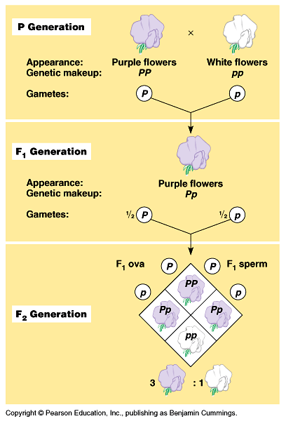
Interpret results
Interpretations are based on the assumptions made : factors represent traits, there are two factors for each trait in each plant – one maternally derived and the other paternally derived
Starting with PP and pp plants in the second generation (F2) we will end up with 3: 1 phenotypic ratio when the factors (P, p) segregate from each other during gamete formation
Note this term segregation:
Questions: What segregates? When ?
What is the evidence of their segregation?
This also called a monohybrid cross

Slide 12
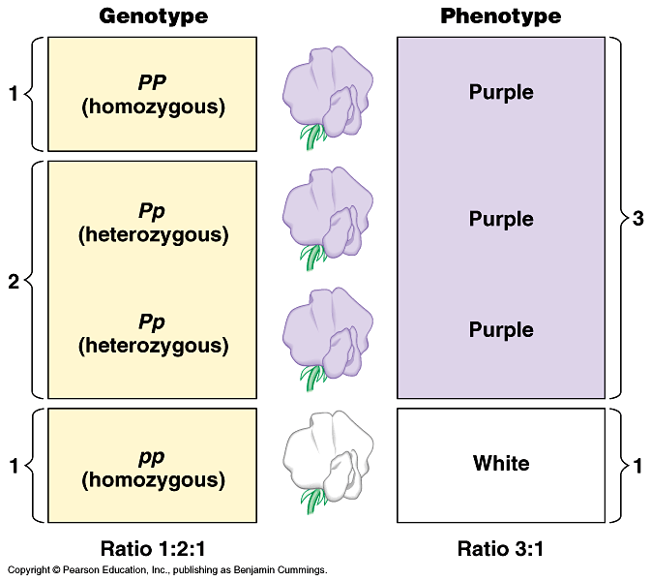
Genotypic and phenotypic ratios in F2 generations
Homozygous
Heterozygous
Homozygous

Slide 13
Let’s consider inheritance of two different pairs of factors
What does R and r mean?
Which one is dominant?
Character : texture of the seeds
Traits smooth (R ) and rough ( r)
Pp
Character : color of the seeds
Traits yellow (Y) and green (y)
Mono
If a plant is true breeding smooth and yellow – how can we represent its genotype?
RrYy
Di-hybrid
RRYY
If a plant is true breeding rough and green – how can we represent its genotype?
rryy
7/22

Slide 14
What will be the consequence if a true breeding smooth and yellow plant is crossed with another true breeding plant which is rough and yellow?
P1
RRYY X rryy
8/22

Slide 15
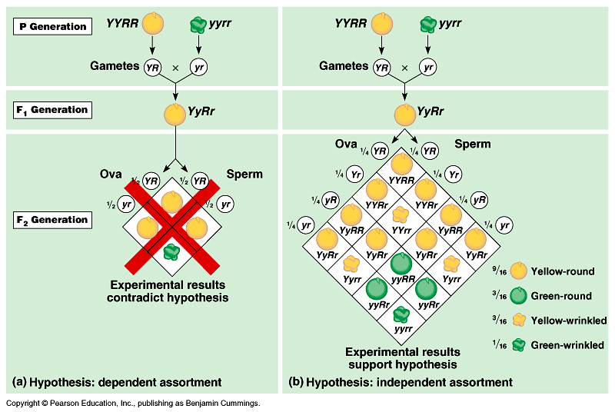
First, find the types of gametes that are possible
dihybrid
Y=1/2
R=1/2
YR=1/4
Second, speculate the outcome if factors of original parent segregate together
Notice, however, that this inheritance follows the law of segregation
These results demands explanation based on an another law of inheritance: namely, the law of independent assortment

Slide 16

The Law of Independent Assortment states that alleles of different genes assort independently of one another during gamete formation.
Alleles: each of two or more alternative forms of a gene(factor) that arise by mutation

Slide 17
Your homework:
Explain the applications of the first and second laws of probability during the formation of the gametes of the F1 parent
P1
F1
F2
The dihybrid ratio

Slide 18
Lecture ends here
Go through the slides again and make your notes
Subsequent slides are for your revision

Slide 19
RECAP
What is assumed here?
Assumption:
For each trait there is one pair of alleles
Law of segregation
Alleles (factors) representing a given trait segregate (separate) during gamete formation, and randomly unite at fertilization.
An interpretation based on first & second law of probability:
Each gamete receive only one of the two alleles (factors)
How this inference was drawn?
How to read ? Example
http://en.wikipedia.org/wiki/Mendelian_inheritance

Slide 20
RECAP
First law of probability
First law of probability
Second law of probability
Second law of probability
The First Law of Probability states that the results of one chance event have no effect on the results of subsequent chance events.
Second Law of Probability, which states that the probability of independent chance events occurring together is the product of the probabilities of the separate events.

Slide 21
This is also called a monohybrid cross. Why??
RECAP

Slide 22
Genetic vocabulary
Alleles: the factors representing a trait. Since we now call these factors as
genes, alleles essentially mean different version of the same gene
Carrier: An individual which is heterozygous, meaning a given pair of allele
are not identical. A carrier often carries a defective version of the
gene along with its normal version
Define the following:
Homozygous: ??
Law of segregation: ??
Phenotype: ??
Trait : ???
Dominant: ???
Connect two terms
Dominant and phenotype
Connect three terms
Dominant , phenotype and allele
Construct a full sentence using all the above terms shown in genetic vocabulary

Slide 23
Let’s revise and solve problems

Slide 24
A law can always be validated further
Test cross
Purple X White
Pp pp
Third Step :
Validate the idea further
??

Slide 25
Solve problem: Application of Mendelian laws in understanding human inheritance & disease
Background Information
β-thalassemia is a form recessive genetic disorder that reduces the production of hemoglobin. In acute cases it is lethal. www.ygyh.org/thal/inherited (your genes your health)
Observation
Baby with Beta-thalassemia is born to a couple who were otherwise normal
Question
How will you explain this observation?
Unpack the problem first
beta-thalassemia is a recessive genetic disorder while the parents are normal: this means that both the parent are heterozygous and therefore carriers. T/t
Progeny of (T/t X T/t) would thus be: (T/T, T/t and t/t)
Since beta-thalassemia is recessive genetic disorder the unfortunate baby was genotypically t/t

Slide 26
Use the following words to complete the sentence below allele(s), diploid, gamete(s), gene, haploid
A ______organism contains two _____ of each ______ in all cells except its _________which are _________ and contain only one.

Slide 27
Use the following words to complete the sentence below. dominant, homozygous, non-identical, heterozygous, identical
All non-reproductive cells contain two alleles of each gene. When those alleles are ____________, the cell is said to be _____________. When those alleles are _____________, the cell is said to be _______________, in which case the cell’s (or organism’s) phenotype is dictated by the _____________ allele.

Slide 28
Problem
The tyrosinase gene, TYR, is necessary for production of the skin pigment melanin in humans. A recessive allele, tyr, of this gene causes the most frequent form of albinism. Homozygotes (tyr / tyr) do not produce melanin, while heterozygotes (TYR / tyr) are unaffected. What is the probability that a child born to a couple, both heterozygous for (TYR/tyr) will be albino?
Your answer should be based on use of the correct symbols
Define the terms used in the above question

Slide 29
Problem
1. One gene has alleles A and a. another has allele B and b. For each genotype, what type(s) of gametes will form? Assume that independent assortment occurs.
a. AABB
b. AaBB
c. Aabb
d. AaBb
Answers:
Parental genotype | Gamete types formed
AABB | AB
AaBB | AB (1/2) & aB(1/2)
Aabb | Ab (1/2), ab(1/2)
AaBb | AB (1/4), Ab (1/4) aB (1/4), ab (1/4) | Explain why there are four types of gametes

Slide 30
Home work
2. What will be the genotypes of offspring from the following matings? Indicate the frequencies of each genotype among. Display your results in Punnett squares
a. AABB x aaBB
b. AaBB X AABb
c. AaBb X aabb
d. AaBb X AaBb
Step 1: In each case, first identify the types gametes formed by each parent
Step 2: Place these gametes at the designated positions in a Punnett square
Step 3. Display the genotypes of the products of fusion of these various gametes in the Punnett square
Step 4. Describe the phenotypes of the genotype of the progeny and their ratios

